Slide 1
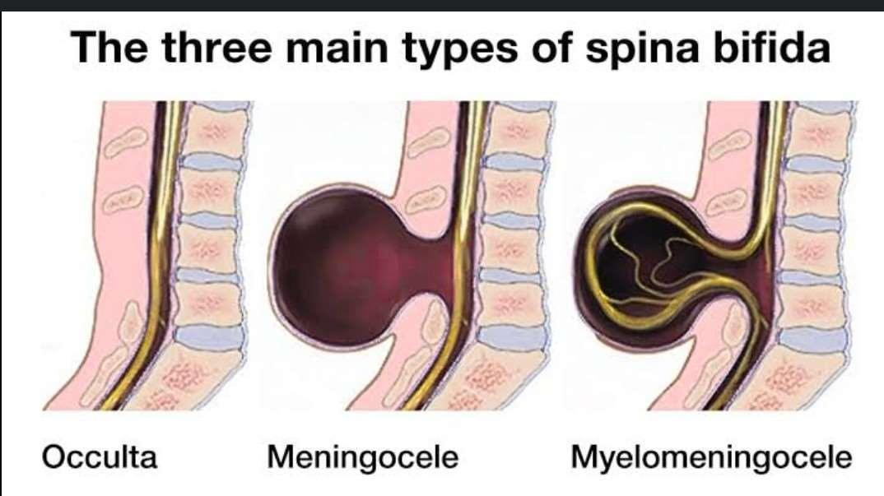
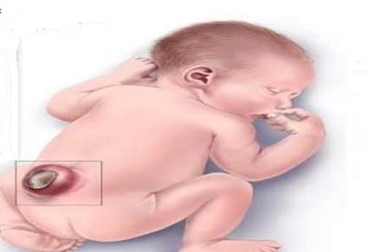
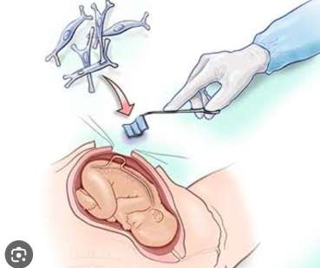
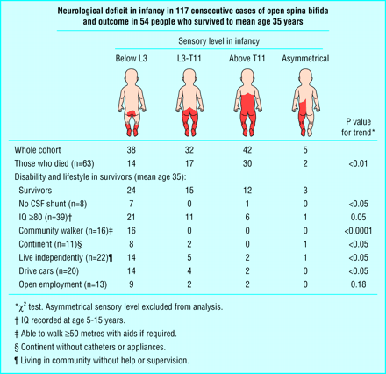
SPINA BIFIDA TREATMENT AND PREVENTION
DR. ULFAT SARDAR
M.Sc Scholar-University of Buckingham, UK
Introduction
• Low folic acid intake during pregnancy
• Family history of spina bifida
• Medicines – taking certain medicines such as valproic acid during pregnancy
Spina Bifida is often detected during the mid pregnancy anomaly scan, which is offered to all pregnant women between 18 and 21 weeks of pregnancy.
• Surgery soon after birth to close the opening in the spine and treat hydrocephalus
• therapies to help make day-to-day life easier and improve independence, such as physiotherapy and occupational therapy assistive devices and mobility equipment, such as a wheelchair, or walking aids
• Treatments for bowel and urinary problems
• With the right treatment and support, many children with spina bifida survive well into adulthood.
It can be a challenging condition to live with, but many adults with spina bifida are able to lead independent and fulfilling lives.
Spina bifida surgery is a medical procedure used to treat the birth defect where the spinal cord doesn't fully developed. The surgery aims to correct the opening in the spine and protect the spinal cord. It's typically performed shortly after birth, but in some cases it might be done in later childhood.
The best way to prevent spina bifida is to take folic acid supplements before and during pregnancy.
Folic Acid recommendations:
• You should take a 400 microgram folic acid tablet every day while you're trying to get pregnant and until you're 12 weeks pregnant.
• Foods like broccoli, spinach and chickpeas are also good source of folic acid
• Women at higher risk of having a child with spina bifida need to be prescribed a higher (5 milligram)
dose of folic acid by a GP.
Shine, the spina bifida and hydrocephalus charity, can provide you with details about local support groups and organisations.
1. Scott Adzick, N. (2013). Fetal surgery for spina bifida: Past, present, future. Seminars in Pediatric Surgery, 22(1), 10-17. https://doi.org/10.1053/j.sempedsurg.2012.10.003
2. NHS (2019). Spina bifida. [online] NHS. Available at: https://www.nhs.uk/conditions/spina-bifida/.
Spina bifida is when a baby's spine and spinal cord does not develop properly in the womb, causing a gap in the spine.“
There are several different types of spina bifida, including:
1. Myelomeningocele:
baby's spinal canal remains open along several vertebrae in the back, allowing the spinal cord and protective membranes around it to push out and form a sac in the baby's back.
2. Meningocele:
The protective membranes around the spinal cord (meninges) push out through the spine; the spinal cord usually develops normally so surgery can often be used to remove the membranes without damaging the nerves.
3. Spina Bifida Occulta:
1 or more vertebrae does not form properly, but the gap in the spine is very small.
Fetal Surgery of Spina Bifida:
Help & Support
Etiology of Spina Bifida:
Types of Spina Bifida:
Diagnosing Spina Bifida:
References
Rx of Spina Bifida:
Preventing Spina Bifida & Folic Acid:

